Slide 1
Article-Level Fake News Detection With BERT-Derived Natural Language Processing Architectures
W266 Final Project
Kenneth Pong, Stacy Irwin
8 Dec 2020

Slide 2
Overview
Fake news detection using variants of BERT model (DistilBERT, RoBERTa; Longformer attempted)
Baseline model: DistilBERT, combined dataset
Final model: Two-stage final model - Document classifier sending articles to separate models trained on source-specific dataset
Dataset: FakeNewsNet

Slide 3
Dataset Overview
FakeNewsNet
Article sources from GossipCop (GC) and PolitiFact (PF) websites
Far more GC articles than PF articles (~20,000 vs ~1,000)
Gossipcop articles imbalanced - more real articles
 | Real | Fake | Total
Politifact (PF) | 560 (58.8%) | 392 (41.2%) | 952
Gossipcop (GC) | 15,373 (75.8%) | 4,891 (24.2%) | 20,264
Total | 15,933 | 5,283 | 21,216

Slide 4
Example Articles
Penniless California issues IOUs to firms, clinics, taxpayers and students
Lindsay Lohan wants Ben Affleck to help her get Batgirl role
San Juan City Council Votes Unanimously To Impeach Trump-Hating Mayor
Pitbull sends private plane to Puerto Rico to transport cancer patients
Busy Phillips freaks out, claims she was ‘almost murdered’ by a stranger in an Uber
Chinese lunar rover finds no evidence of American Moon landing
Jennifer Aniston's Dinner Invite Rejected by Angelina Jolie
Trump asking Congress, not Mexico, to pay for border wall

Slide 5
Preprocessing
Github data repository did not contain actual articles
URLs to Articles
Article Titles
Unique Article ID Code
Downloaded data using scripts supplied by FakeNewsNet
Articles <= 500 characters removed
Most were error messages or stub articles
Split Data
60% training
20% development
20% test (reserved for final model evaluation)
Organization names (e.g. New York Times, PBS News Hour) removed from titles

Slide 6
DistilBERT Baseline and Fine Tuning Framework
DistilBERT
Trained using distillation training
Loss computed using BERT’s output probabilities (instead of one-hot labels)
Faster inference than standard BERT
40% smaller, 60% faster
Faster-training model let us focus on development, do more testing
One model trained combining GC, PF articles
Fine-Tuning Framework
Acquired pre-trained Pytorch models from Huggingface.co/transformers
Cross-entropy loss
AdamW optimizer
On several models, provided heavier weighting (4 to 1) to fake article losses to compensate for imbalanced data set

Slide 7
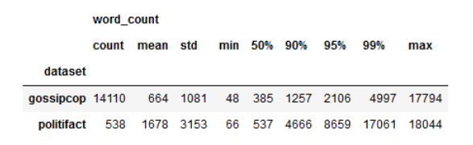
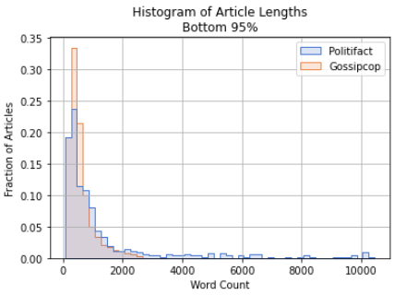
Post-Baseline - Longformer and Issues
Longformer
4,096 token length limit - great for articles?
Standard token limit (512) only fully captures ⅔ of GC articles, ½ of PF articles
Attention mechanism scales linearly with sequence length, not quadratically
Initial results on PF dataset comparable to DistilBERT equivalent
Issues
Longer runtime than DistilBERT
Small batch sizes (<=8)
GC dataset failed to train after five epochs

Slide 8
Post-Baseline - RoBERTa, Topic Chooser
RoBERTa
Better performance metrics than standard BERT
Trained using longer sequences, 10x data, bigger batches
Next sentence prediction not used; dynamic masking to change masked token between epochs
Two models - one each for GC, PF (Combined dataset model did not train)
Topic Chooser
Two-stage approach involving DistilBERT-based document classifier model feeding RoBERTa-based fake news evaluation models

Slide 9
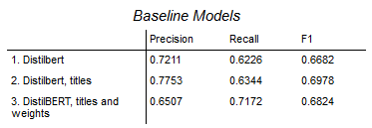
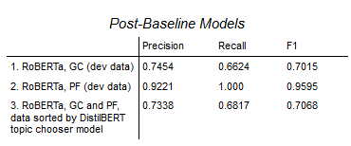
Results
Titles improved both precision and recall
Weights traded precision for recall
Topic choose-fed RoBERTa model beat DistilBERT baseline slightly
Final model performance more balanced than baseline
PF articles easier to classify than GC articles despite much larger training set
Possible explanation: PF articles differ significantly between fake, real classes, but GC articles use most of the same words
Error analysis: Models were highly confident even on inaccurate predictions

Slide 10
Example Articles - Which Ones Are Fake?
Penniless California issues IOUs to firms, clinics, taxpayers and students
Lindsay Lohan wants Ben Affleck to help her get Batgirl role
San Juan City Council Votes Unanimously To Impeach Trump-Hating Mayor
Pitbull sends private plane to Puerto Rico to transport cancer patients
Busy Phillips freaks out, claims she was ‘almost murdered’ by a stranger in an Uber
Chinese lunar rover finds no evidence of American Moon landing
Jennifer Aniston's Dinner Invite Rejected by Angelina Jolie
Trump asking Congress, not Mexico, to pay for border wall

Slide 11
Example Articles - Which Ones Are Fake?
Penniless California issues IOUs to firms, clinics, taxpayers and students
Lindsay Lohan wants Ben Affleck to help her get Batgirl role
San Juan City Council Votes Unanimously To Impeach Trump-Hating Mayor
Pitbull sends private plane to Puerto Rico to transport cancer patients
Busy Phillips freaks out, claims she was ‘almost murdered’ by a stranger in an Uber
Chinese lunar rover finds no evidence of American Moon landing
Jennifer Aniston's Dinner Invite Rejected by Angelina Jolie
Trump asking Congress, not Mexico, to pay for border wall

Slide 12
Any Questions?

